Slide 1
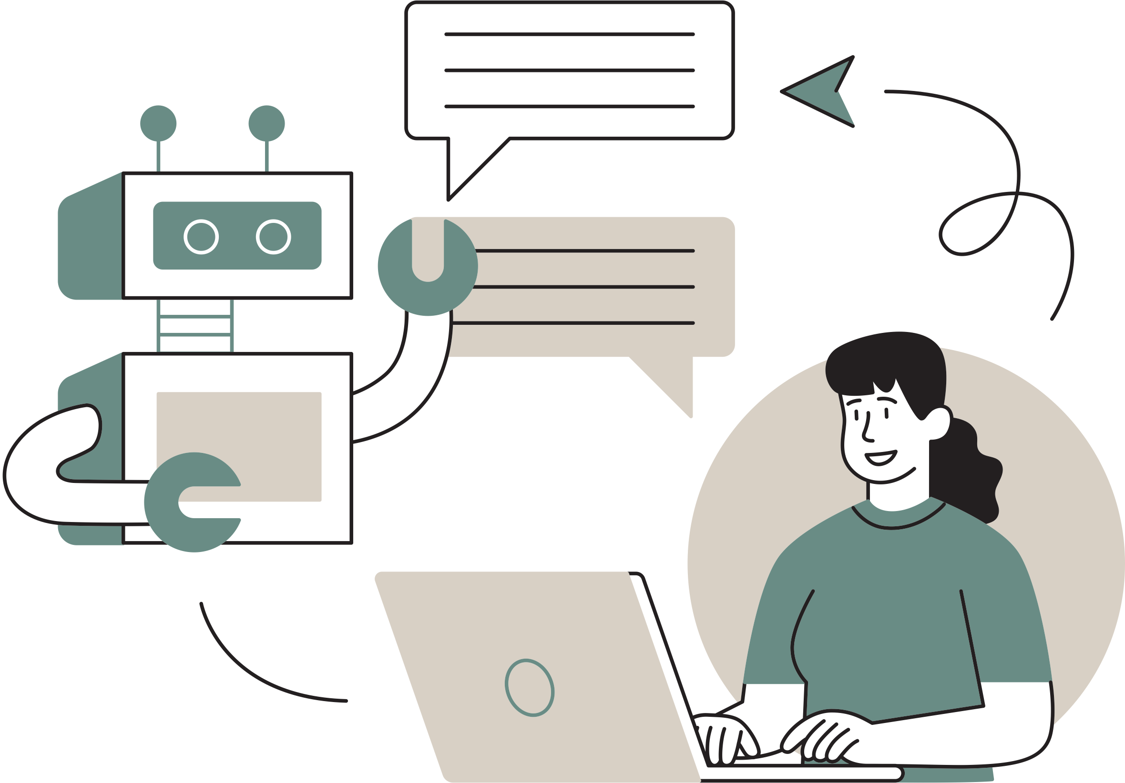
THERAPEUTIC COMPANION BOT
MAHIKSHIT KURAPATI
POOJA CHANDRASHEKARA

Slide 2
1
Introduction
Contents
2
Literature review
3
Methodology
4
Results and Analysis
5
References
6
Conclusion

Slide 3

What is a Therapeutic Chatbot?
A therapeutic chatbot is an AI application designed to offer psychological support through conversations, using techniques like cognitive-behavioral therapy to help users manage mental health issues.

Slide 4
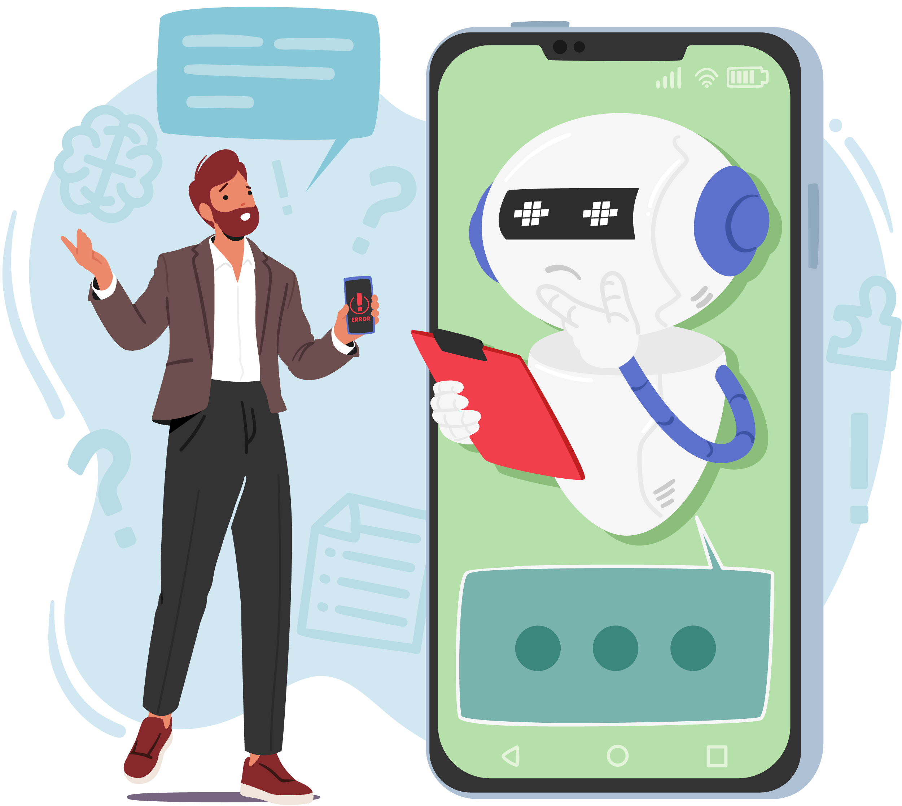
Problem Statement
1
Overcoming Traditional Barriers
2
Scarce Mental Health Resources
3
Supplementary Support
4
Technological and Ethical Complexity

Slide 5
Problem Statement Elaboration
Overcoming Traditional Barriers
Lack of Mental Health Providers
Supplementary Support
Technological and Ethical Complexity
The project targets the prevalent issues of high cost, limited accessibility, and societal stigma that deter people from seeking traditional mental health solutions.
Critical shortage of mental health professionals, with a ratio of one therapist or social worker to every 10,000 patients, even in developed countries
Providing an additional layer of support through the chatbot, especially for those who cannot access immediate help, enhances but does not replace professional mental health services.
Developing a chatbot capable of understanding a wide range of human emotions while ensuring adherence to ethical standards and privacy laws.

Slide 6

motivation
Addressing WHO's projection of 1 billion people with mental illness and the global shortage of mental health professionals.
Utilizing AI and machine learning for 24/7 accessible mental health support, overcoming cost, accessibility, and stigma barriers.
Supplementing traditional therapy, the chatbot serves as both a preliminary tool for professionals and a direct aid for those seeking immediate support.

Slide 7
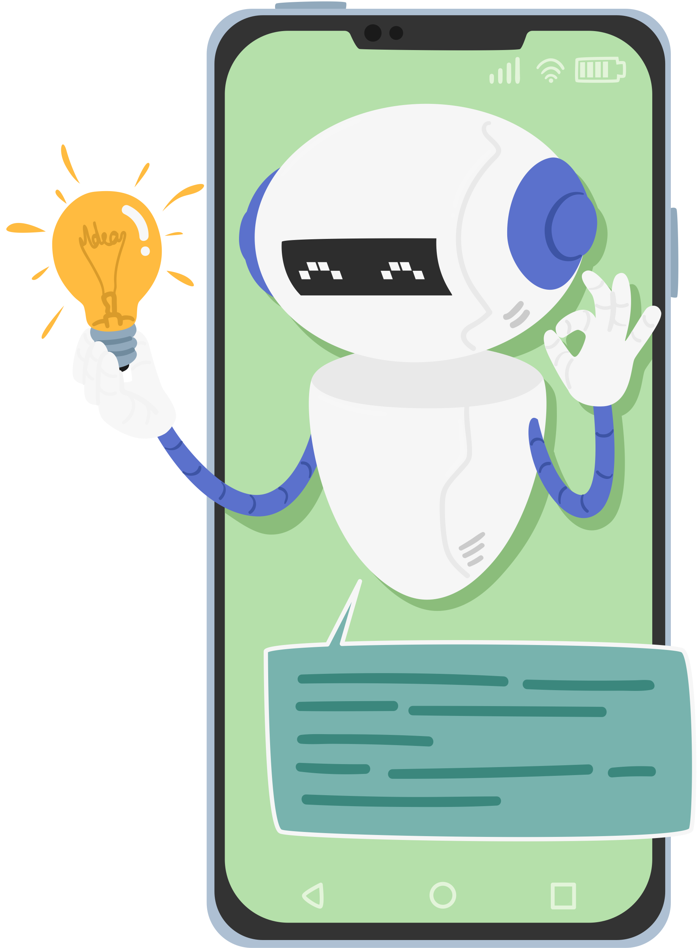
Project Scope
Cognitive Therapy
24/7 Support
Advanced NLP
Data Security
Privacy Adherence
Machine Learning
Emotional Intelligence
Ethical Standards
Smartphone Access
Secure Framework

Slide 8
Literature review
relevant research
Emotion Regulation Chatbots
Support for Students' Mental Health
NLP and Psychotherapy Chatbots
AI in Depression Management
Discussed SERMO's usability in aiding emotion regulation through cognitive behavior therapy methods, emphasizing its potential global mental health support​
Demonstrated how a chatbot could provide mental health support similar to a counselor or therapist, utilizing technology in mental health recovery​
Explored the usage patterns of chatbots in depression, highlighting the engagement with Tess and the diverse user interaction across different modules
Surveyed the application of NLP in psychotherapy, proposing MentalEase to offer conversational aid and a suite of features for mental health maintenance​

Slide 9

dataset collection
Extensive Data Collection: Accumulated approximately 3GB of diverse data, encompassing mental health discussions and studies.
Multiple Platforms: Sourced data from prominent platforms such as Kaggle, Hugging Face, and the World Health Organization.
Varied Data Formats: Compiled a rich dataset in formats including CSV, PDF, JSON, and plain text to support comprehensive analysis.
Comprehensive Coverage: The dataset integrates various aspects of mental health, ensuring a broad perspective for our project.

Slide 10

Dataset description
1
Diverse Data Sources: Data from depression subreddit pages, conversations between psychiatrists and patients from Kaggles, and a multi-faceted view of mental health discussions from the Hugging Face website.
2
Varied Formats: Combines CSV, JSON, PDF, and Parquet files from HuggingFace for a comprehensive dataset on mental health interactions.
3
Global Standards Compliance: Features a WHO rules and ethics statement on mental health, ensuring adherence to ethical AI development practices.
4
Ethical Framework: Aligns with a 15-year WHO plan, emphasizing responsible handling of mental health issues.
5
Real-World Insights: Provides genuine insights into mental health discussions from various perspectives, enhancing the dataset's relevance.

Slide 11

data
preprocessing
Handled missing values
Regex to remove special characters
Tokenized the data into the corpus of words
Segregated data into question-and-answer format
Divided the data into training and validation sets.

Slide 12
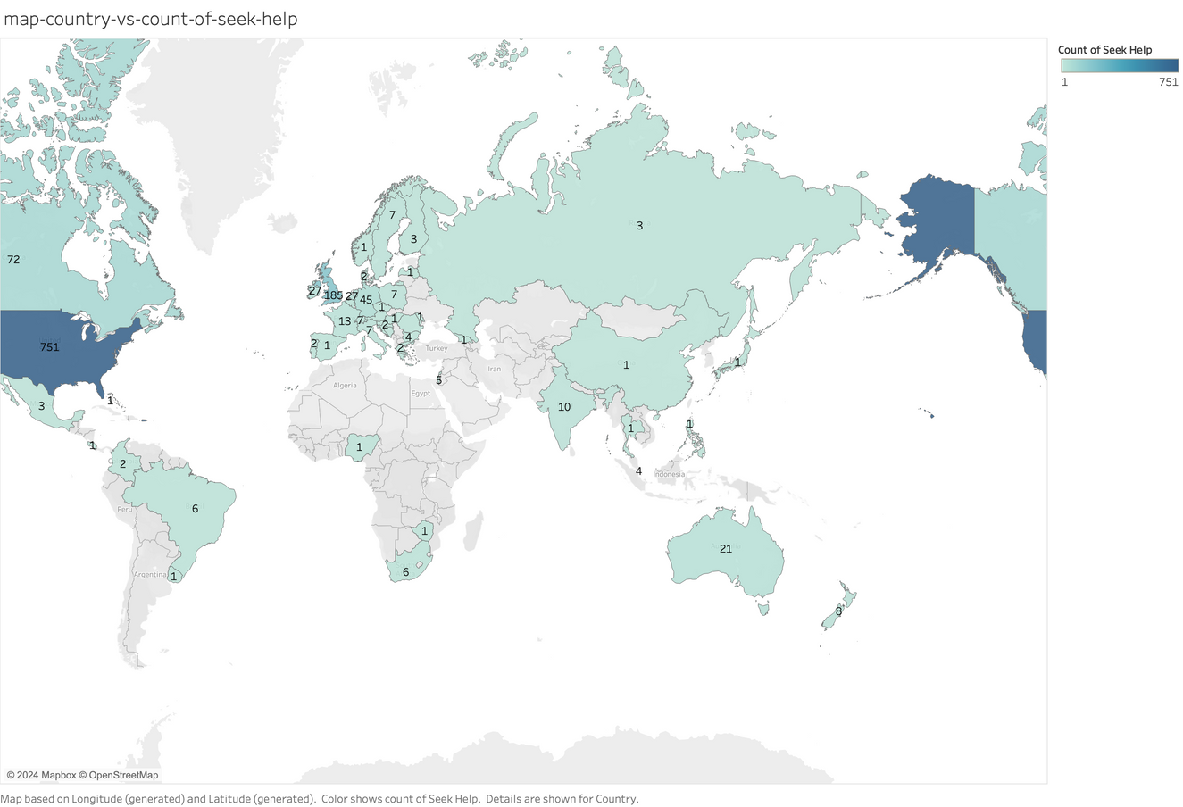
data
visualization
Global Help-Seeking Behavior: Visualization highlights the USA with the highest help-seeking rate at 750 per 10,000 people.
Varied International Figures: Showcases stark contrasts, with India at 10, China at 1, and Turkey, Egypt, and Iran at 0 per 10,000.
Cultural and Accessibility Insights: Suggests significant disparities in mental health service accessibility and cultural attitudes toward seeking help.
Urgent Global Mental Health Needs: Indicates a pressing need for increased mental health support and destigmatization worldwide.

Slide 13
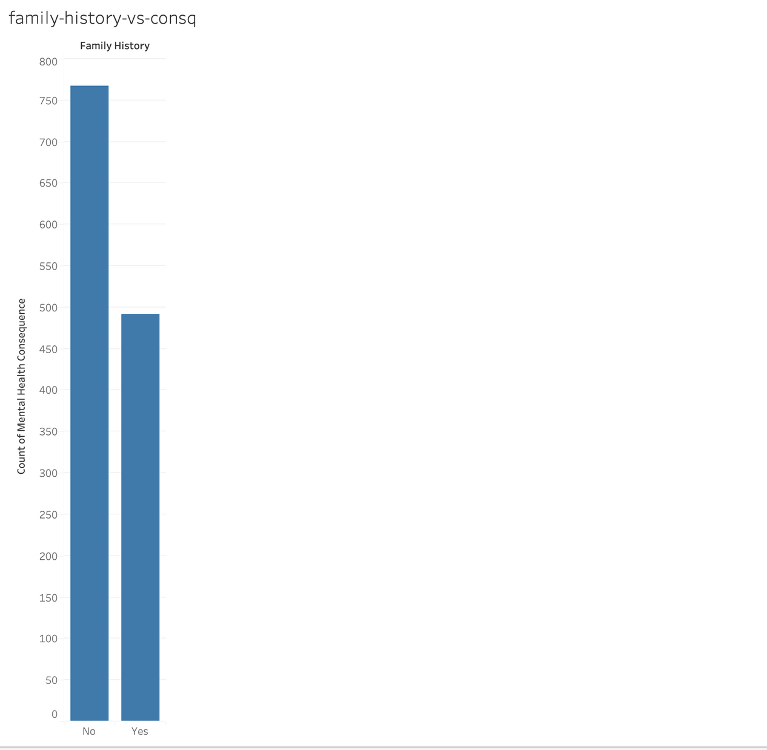
Family History vs Consequence
Mental Health Universality: The data suggests mental health issues can affect individuals regardless of their family history.
Prevalent Concerns: Highlights that the absence of a family history does not necessarily reduce the occurrence of mental health consequences.
Awareness Needed: Underlines the importance of mental health awareness for all, irrespective of family medical background.
Healthcare Outreach: Emphasizes the need for healthcare services to consider individuals without a family history in their mental health support programs.

Slide 14
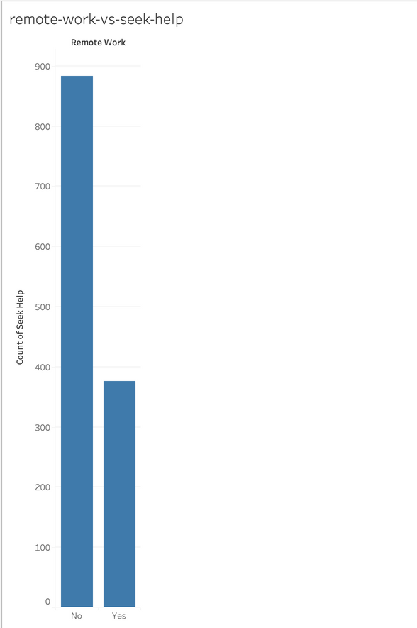
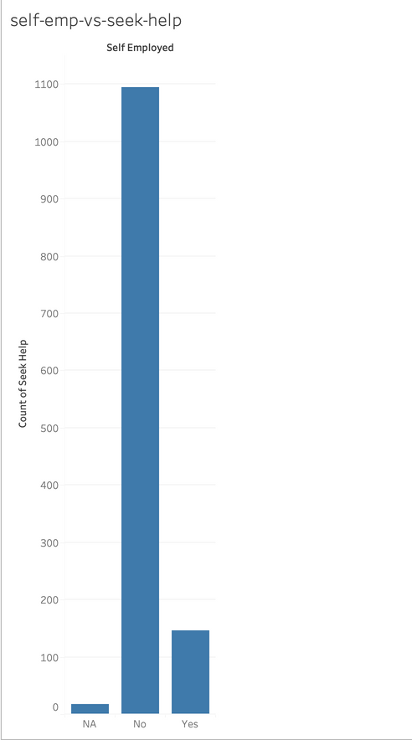
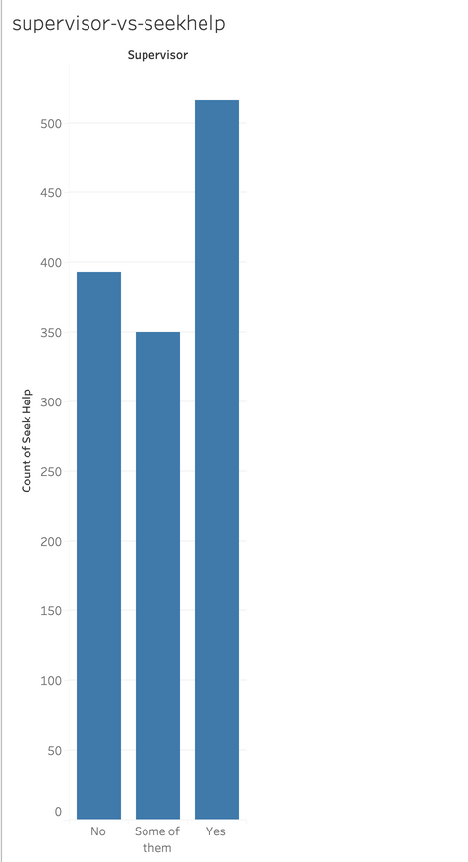
Employment type vs chances of seeking help
Remote Work Correlation: Higher number of individuals engaged in remote work seeking help compared to self-employed people for mental health issues.
Self-Employment Analysis: Self-employed individuals have a lower count of seeking help compared to non-self-employed.
Supervisors: Individuals who are supervisors are more likely to seek help.
Type of work environment.
Seeking Help Dynamics: Employees in traditional work settings might be more inclined to seek help than their remote-working counterparts.
Importance of considering employment type.

Slide 15
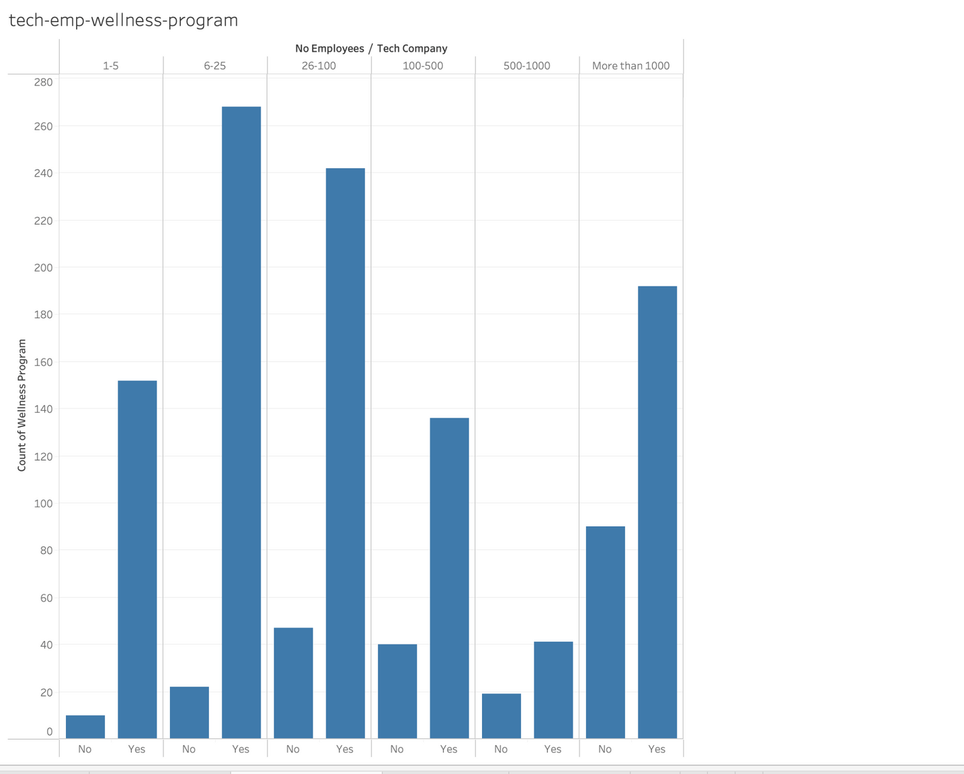
Tech companies vs their wellness program
Industry Responsibility: The tech industry recognizes the importance of mental health support for employees across different company sizes.
Employee Wellness Programs: Larger tech companies with over 1000 employees are more likely to have mental wellness programs.
SME Engagement: Small—to medium-sized enterprises have many wellness programs.
Program Availability: Mid-sized companies (26-100, 100-500 employees) are less likely to offer them than very small or large companies.

Slide 16

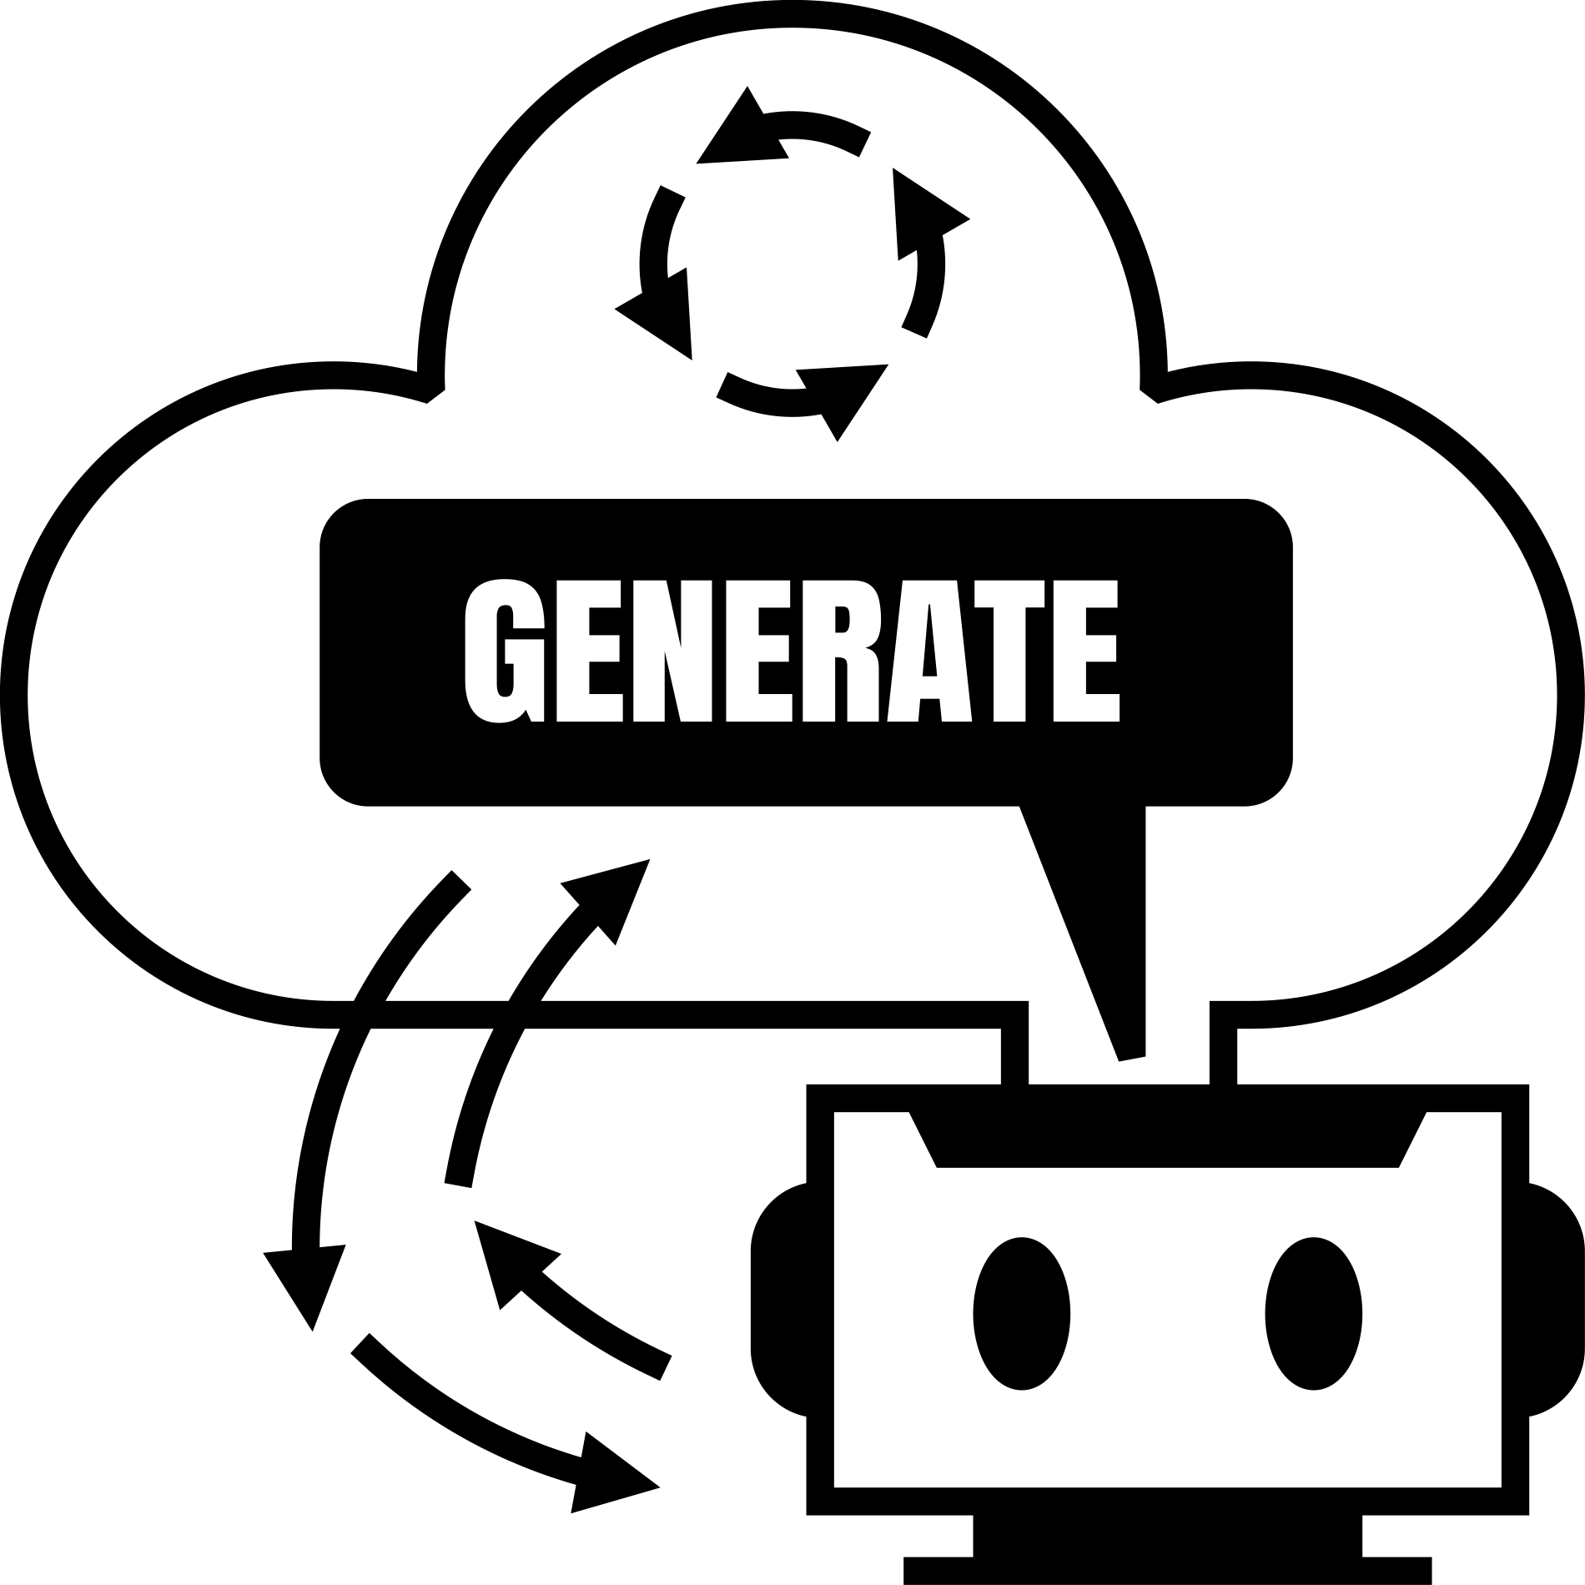

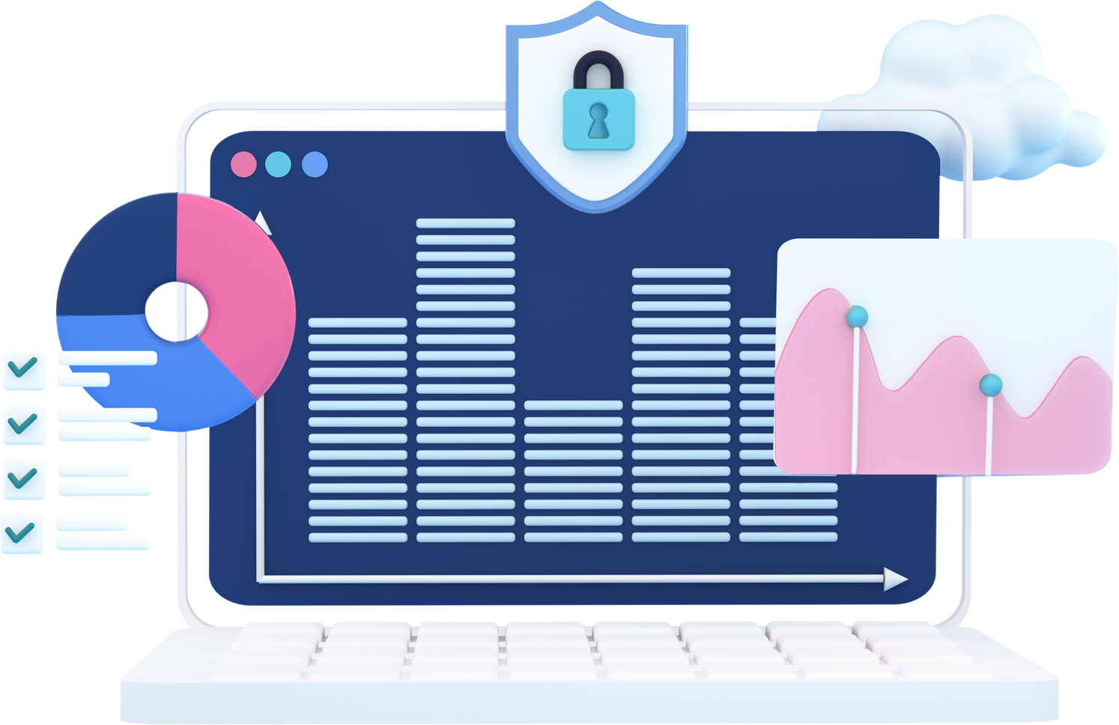
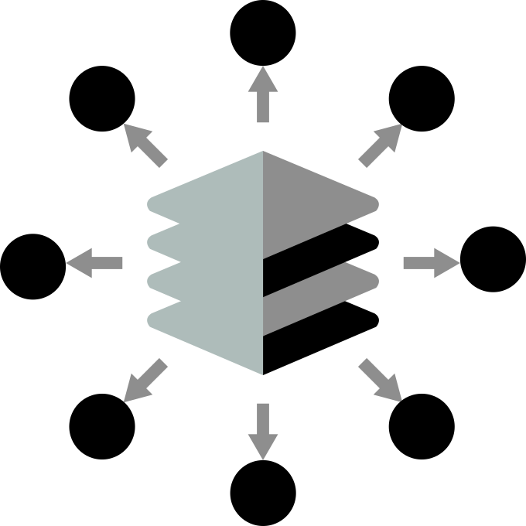
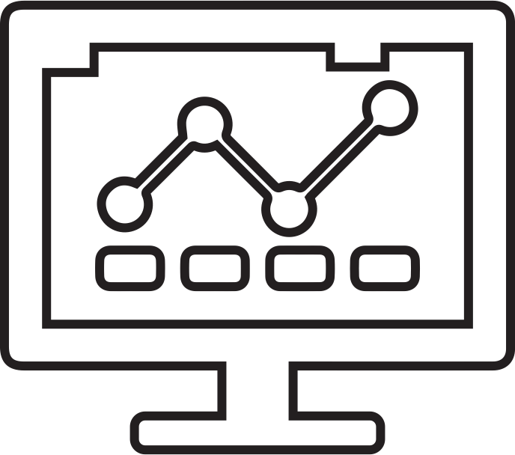




data Modeling

Slide 17

Metrics
Models | Loss Parameter
GPT2 | ~ 0.67
Llama3 | ~ 0.442
TinyGPT | ~ 6.64
GPT2_medium | ~ 0.91
GPT2_large | Couldn’t process due to the limitation of the GPU
Mistral 8x7b | ~ 0.67

Slide 18
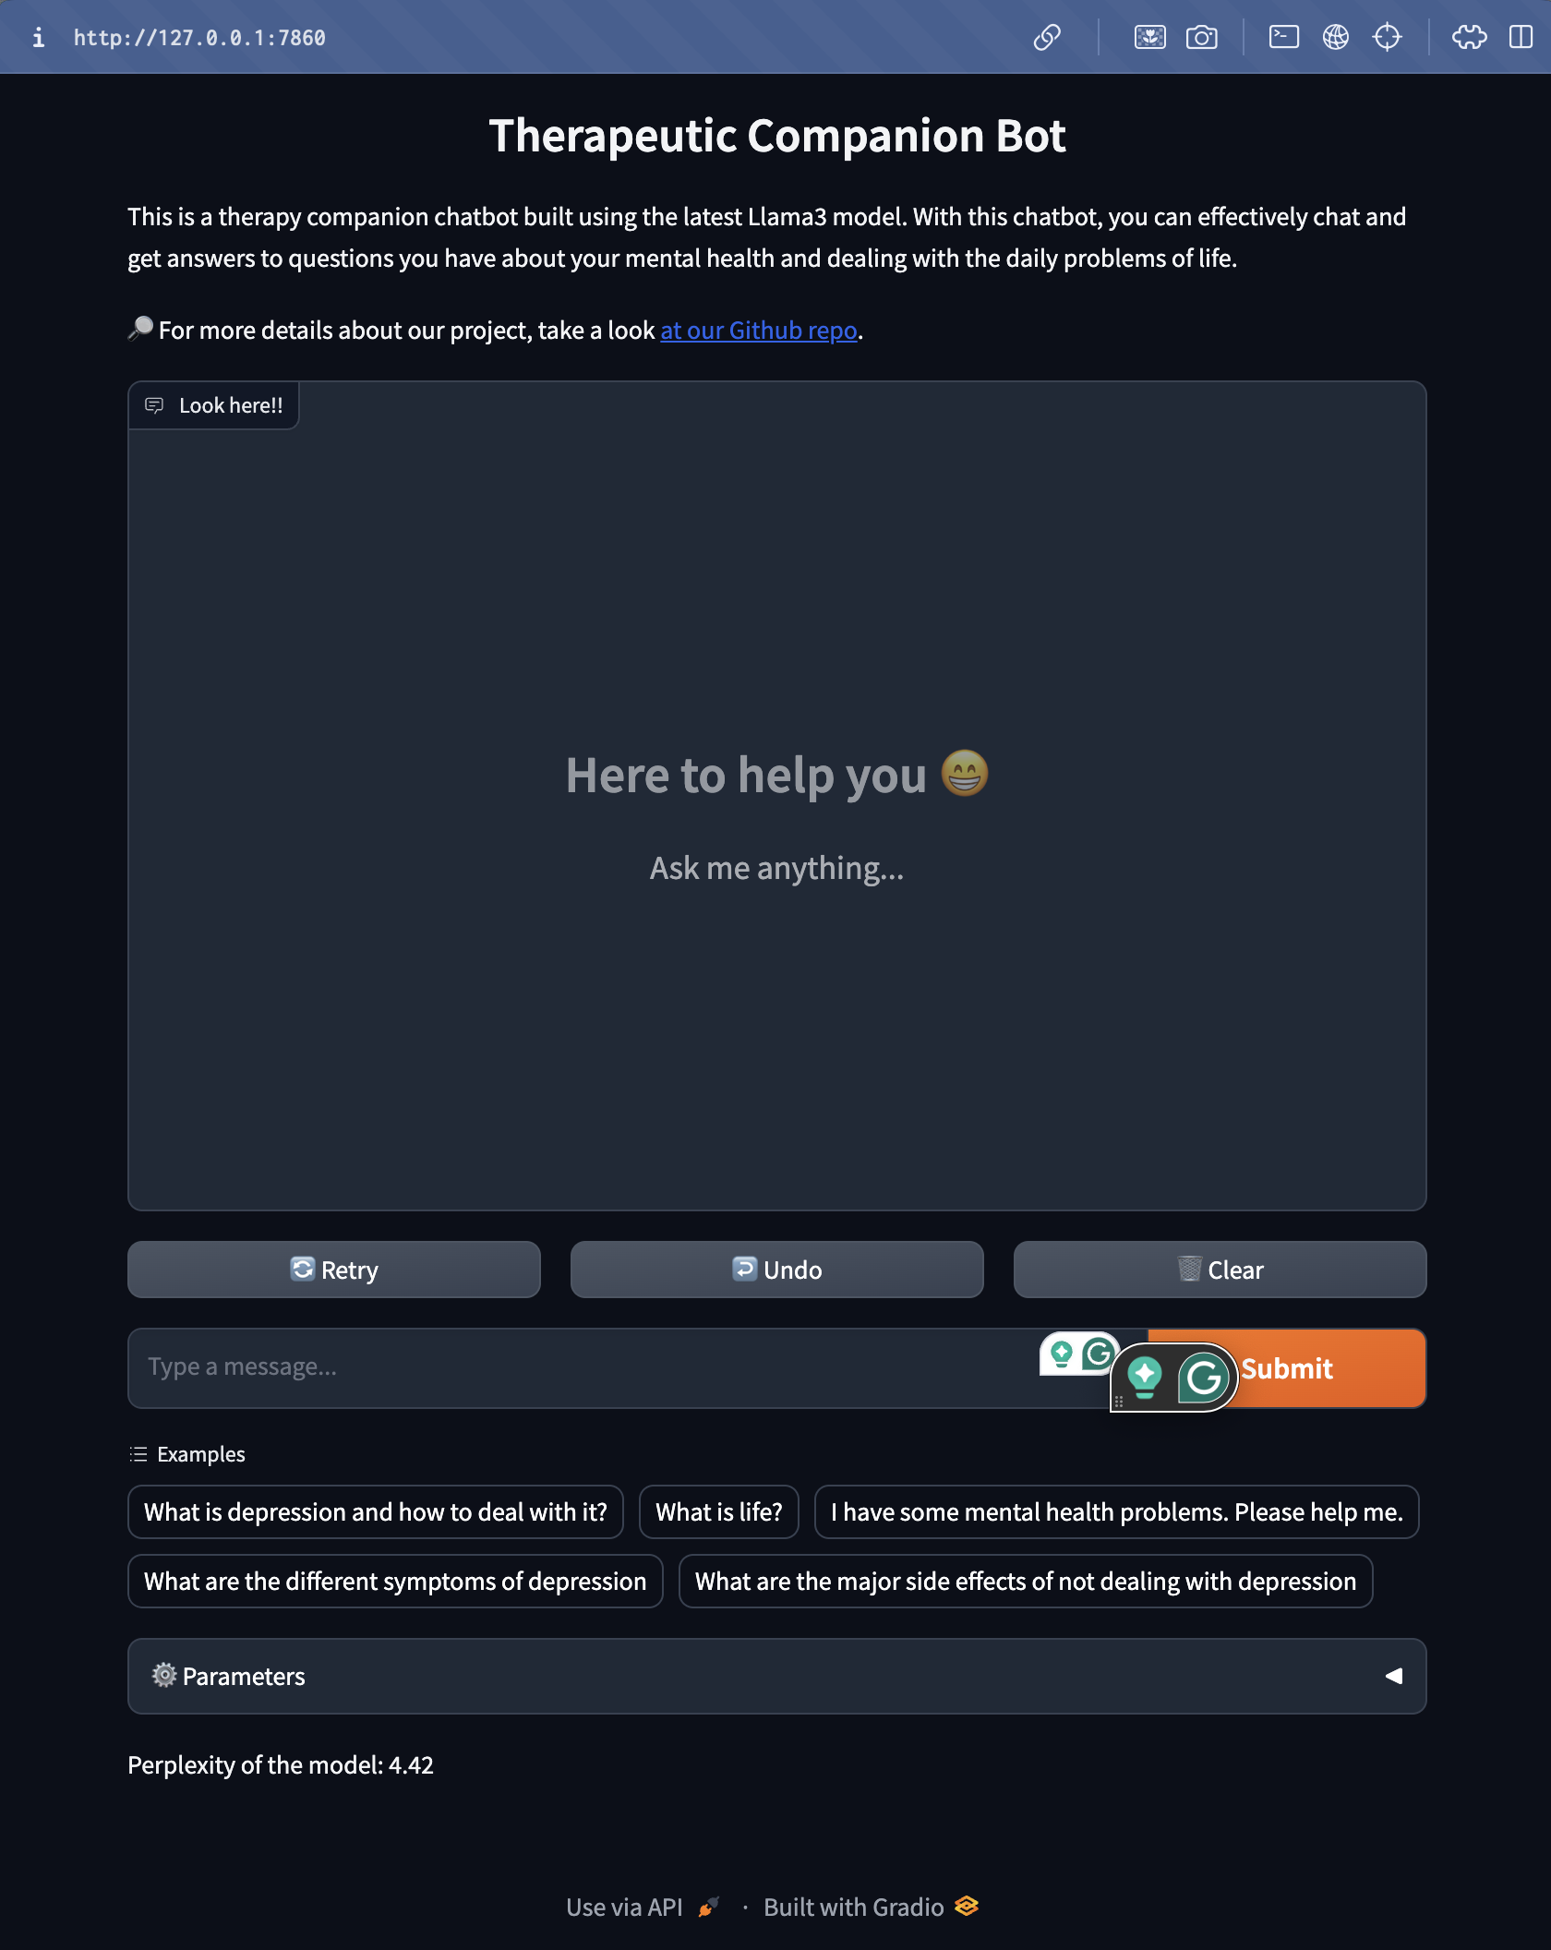
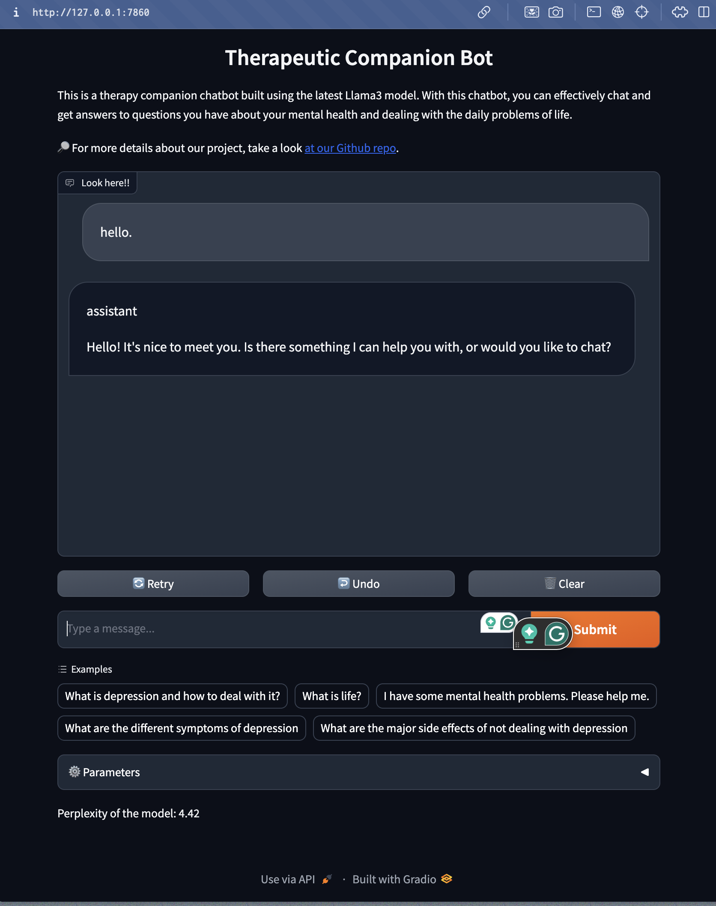
Output

Slide 19
References
Topic | Link
1. Emotion regulation bot | https://www.researchgate.net/publication/370114053_Emotion-regulatory_Chatbots_for_Enhancing_Consumer_Servicing_An_Interpersonal_Emotion_Management_Approach
2. Support for student mental health | https://ieeexplore.ieee.org/document/9544838
3. AI in depression Management | https://www.sciencedirect.com/science/article/pii/S2214782922000021
4. Distilgpt2 model by Hugging Face | https://huggingface.co/distilbert/distilgpt2

Slide 20
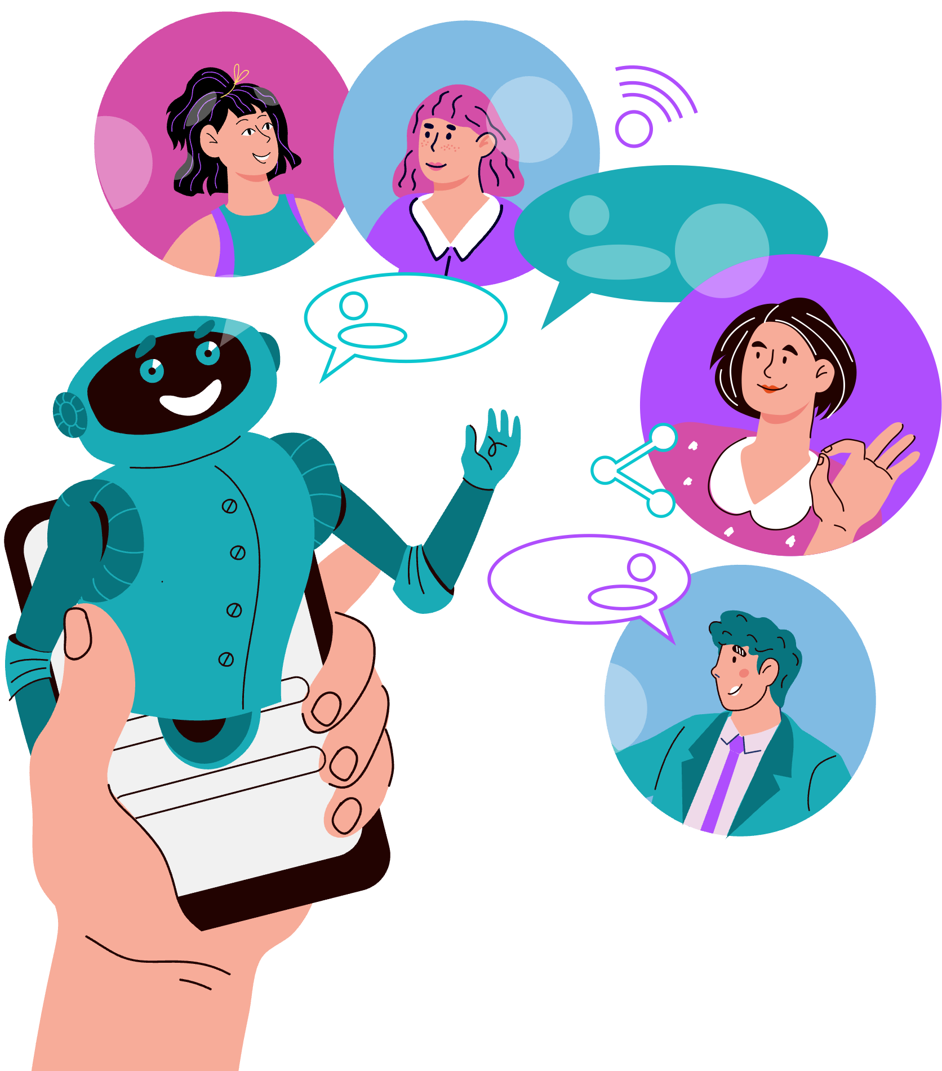
THANK YOU!

